Slide 1

THE HEALTH EFFECTS OF GLOBAL WARMING
:- Allahdad

Slide 2
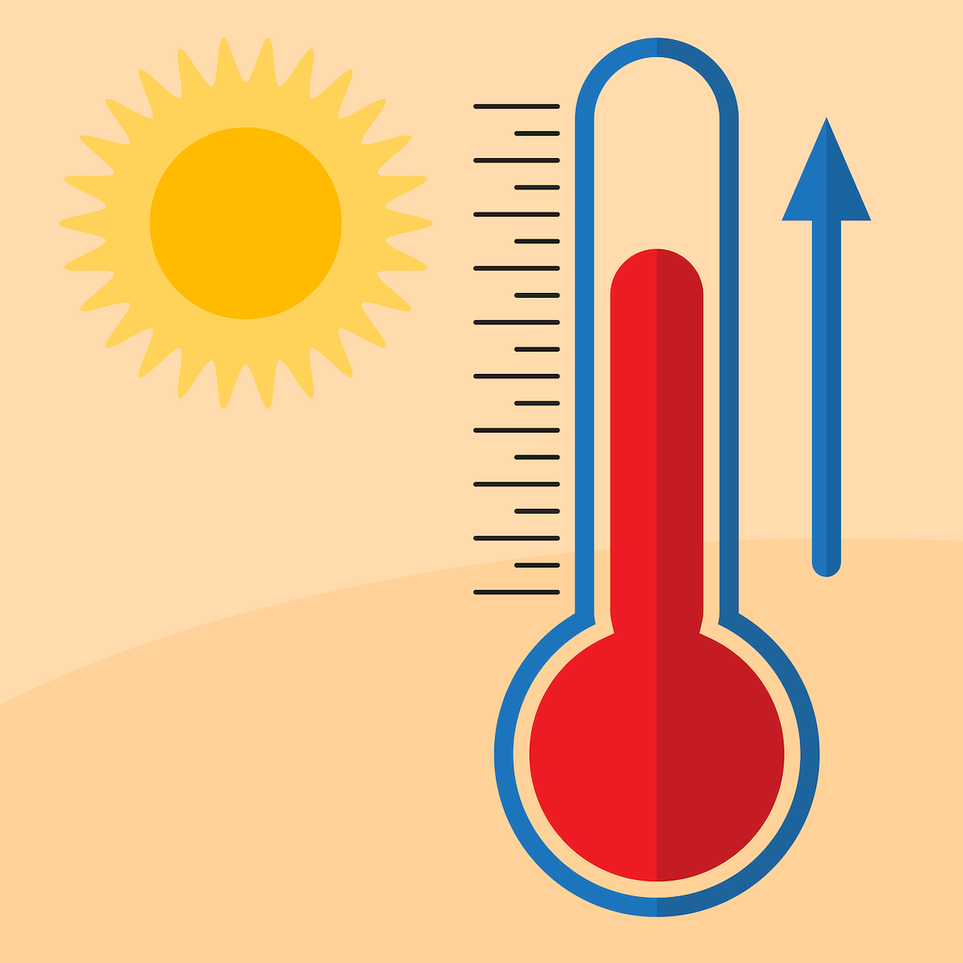
GLOBAL WARMING
What is Global Warning?
Global warming is slow increase in the average temperature of earth’s atmosphere.

Slide 3
GLOBAL WARMING
Effects on Health
Rise of Temperature.
Air Pollution.
Infectious Disease.
Human Migration

Slide 4
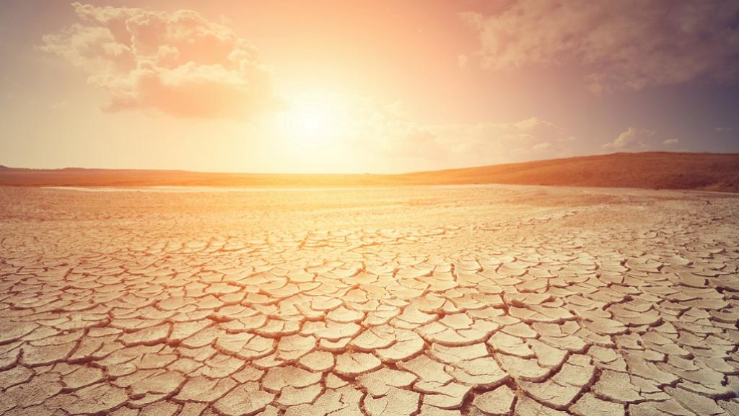
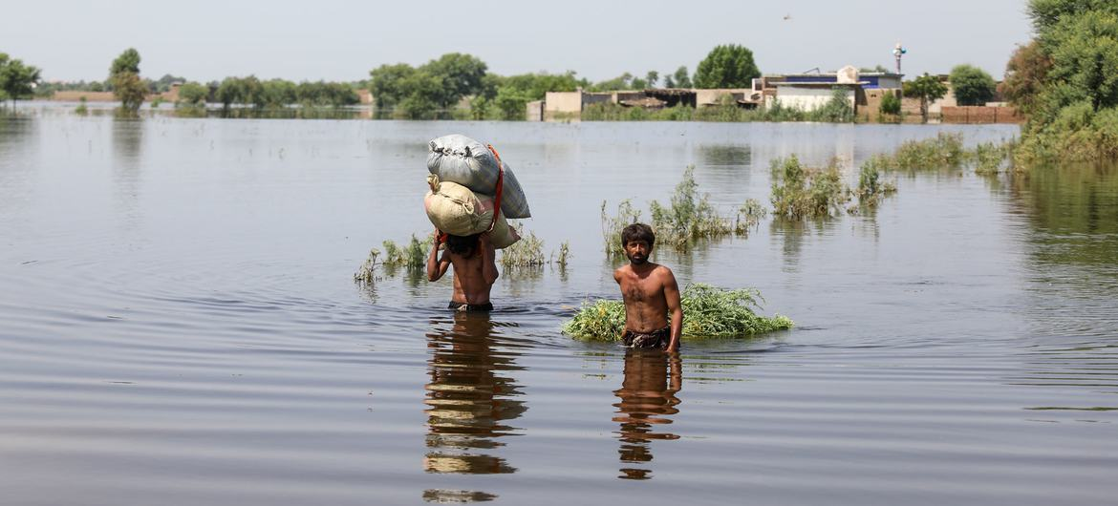
RISE OF TEMPERATURE
Higher Temperature are worsening many types of disasters like:
Storms
Heath Waves
Floods
Droughts

Slide 5
AIR POLLUTION
Short-term exposure to air pollution can cause: | Long-term exposure to air pollution can cause:
Coughing Wheezing/difficulty breathing Irritation to eyes, nose, and throat Headache Dizziness Fatigue | Respiratory diseases (asthma, emphysema) Cardiovascular damage Harm to liver, spleen, and blood Nervous system damage Cancer Birth defects Death

Slide 6
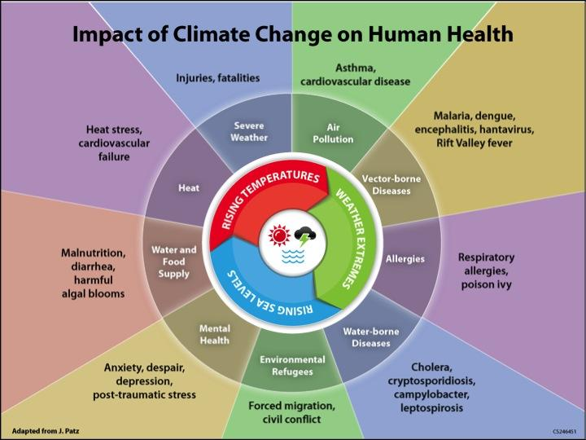
INFECTIOS DISEASES

Slide 7
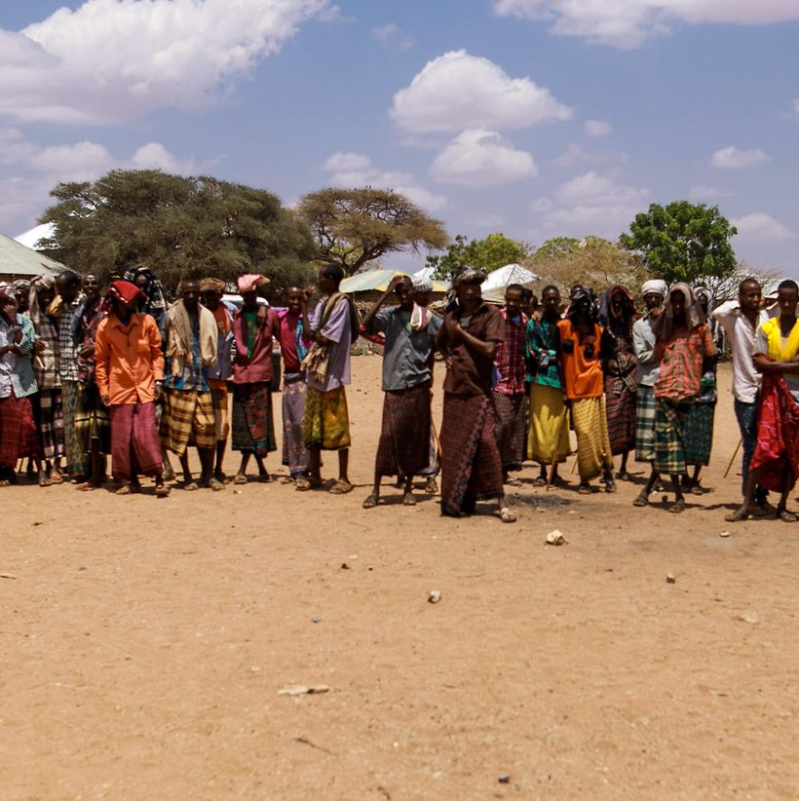
HUMAN MIGRATION
Most climate migrants move within the borders of their homelands, usually from rural areas to cities after losing their home or livelihood because of drought, rising seas or another weather calamity. Because cities also are facing their own climate-related problems, including soaring temperatures and water scarcity, people are increasingly being forced to flee across international borders to seek refuge.

